Slide 1
Bank Marketing Analysis
2022
Aiza Marie Tago

Slide 2
The Data Set
2022
This data set is a marketing campaigns of a Portuguese banking institution. The marketing campaigns were based on phone calls. This was used, to know if the client will subscribe to a term deposit
Source:
[Moro et al., 2014] S. Moro, P. Cortez and P. Rita. A Data-Driven Approach to Predict the Success of Bank Telemarketing. Decision Support Systems, Elsevier, 62:22-31, June 2014
Bank Marketing Data Set

Slide 3
What is a Term Deposit
2022
A Term deposit is a deposit that a bank or a financial institution offers with a fixed rate (often better than just opening deposit account) in which your money will be returned at a specific maturity time.
For more information with regards to Term Deposits please click on this link from Investopedia: https://www.investopedia.com/terms/t/termdeposit.asp
Bank Marketing Data Set

Slide 4
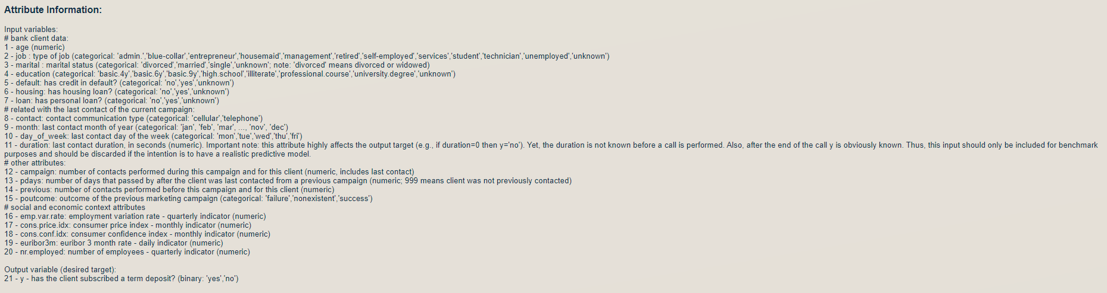
Attribute Description
2022

Slide 5
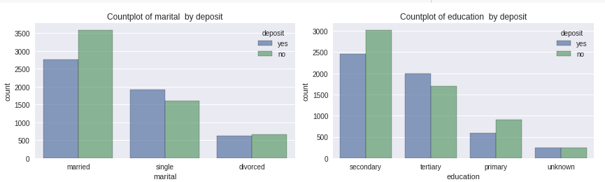
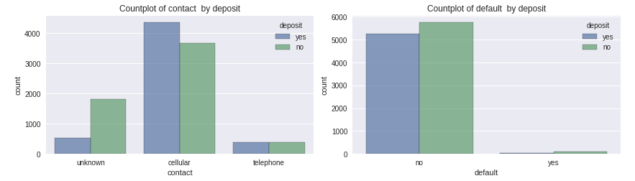
Exploratory Analysis
2022
Marital and Education Attributes
Contact and Default Attributes

Slide 6
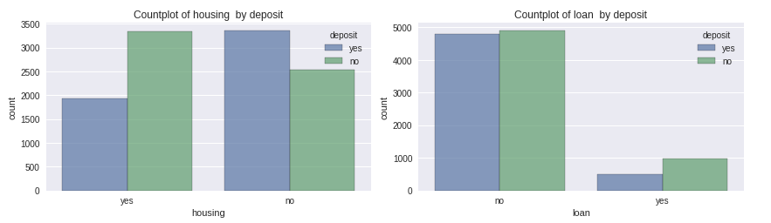
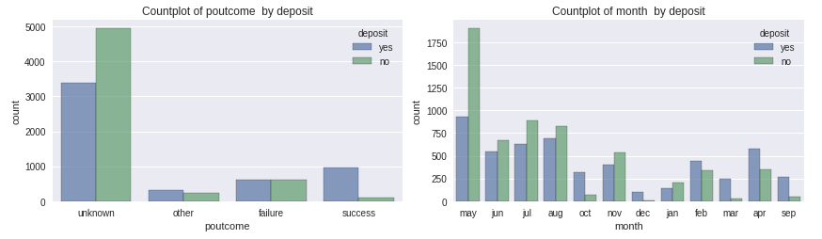
Exploratory Analysis
2022
Housing and Loan Attributes
POutcome and Month Attributes

Slide 7
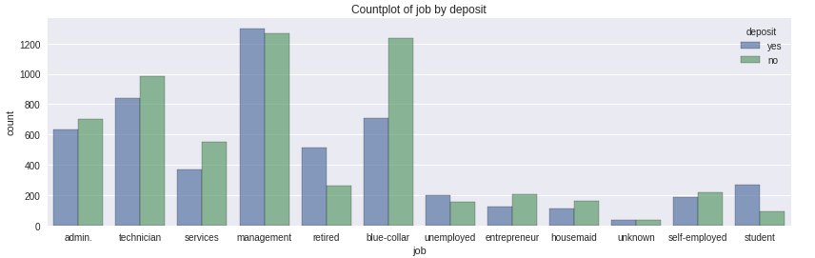
Exploratory Analysis
2022
Job Attribute

Slide 8
Conclusion
2022
Categorical Features- we can conclude that:
Married clients are dominant in data most of them did not subscribe but they are still the biggest subscriber compared to other status. It also shows those with secondary education declined to the subscription but also has the most subscribers to the term deposit
Those who are with no housing loans subscribe to have a term deposit as well those with no personal loans
Most people were contacted in the month of May although it shows the highest among who agreed to subscribe it also has the highest decline
Unemployed, entrepreneur and housemaid are less likely to subscribe. Those who has managerial jobs is showing the highest subscriber but with highest decline too

Slide 9
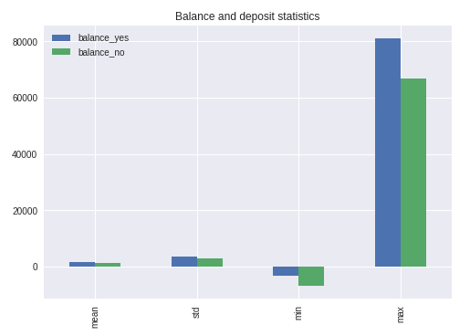
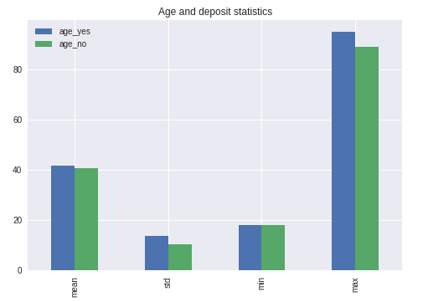
Exploratory Analysis
2022
Balance Attribute
Age Attribute

Slide 10
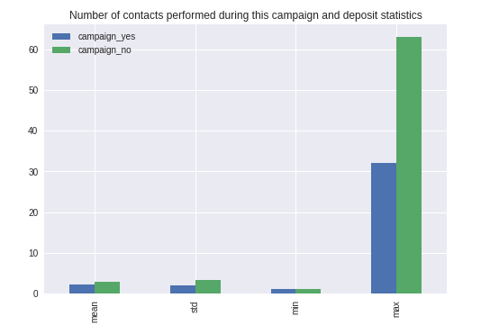
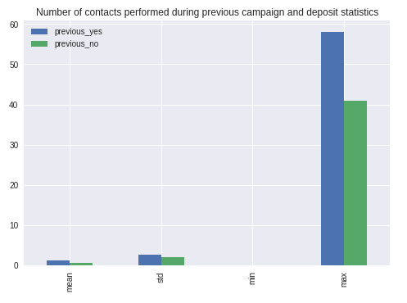
Exploratory Analysis
2022
During this Campaign Attribute
Previous Campaign Attributes

Slide 11
Conclusion
2022
Numerical features- we can conclude that:
Those with greater balance and age values have subscribed for term deposit.
People who subscribed for term deposit tend to have fewer number of contacts during this campaign.

Slide 12

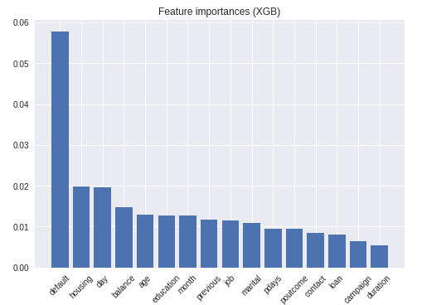
Machine Learning Model
2022
XGBoost is an implementation of Gradient Boosting Decision Trees
Boosting is about combining simple models to build a stronger model. The predictors are trained sequentially, trying to learn from mistakes and trying to correct the previous model.
XGBoost Classifier

Slide 13
Feature Importance
2022
Based on the model the feature that are important are:
Customer's account balance,
Customer's age,
Number of contacts performed during this campaign and contact duration,
Number of contacts performed before this campaign.
Main outcomes of the modelling are:
Customers of greater age are more likely to subscribe for the term deposit.
Customers with greater account balance are more likely to subscribe for the term deposit.

Slide 14
THANK YOU!
2022
Happy Researching!

